Slide 1

Password Security System
DIGITAL LOGIC AND DESIGN PROJECT
Made by:
Javeria Riaz Malik
(2016-CS-251)
Khadija Zahoor Hashmi
(2016-CS-259)

Slide 2
REQUIREMENTS
Password Security System
NOR and XOR gates
4 bit DIP switches
Red LED glow with incorrect password
Green LED glow with correct password

Slide 3
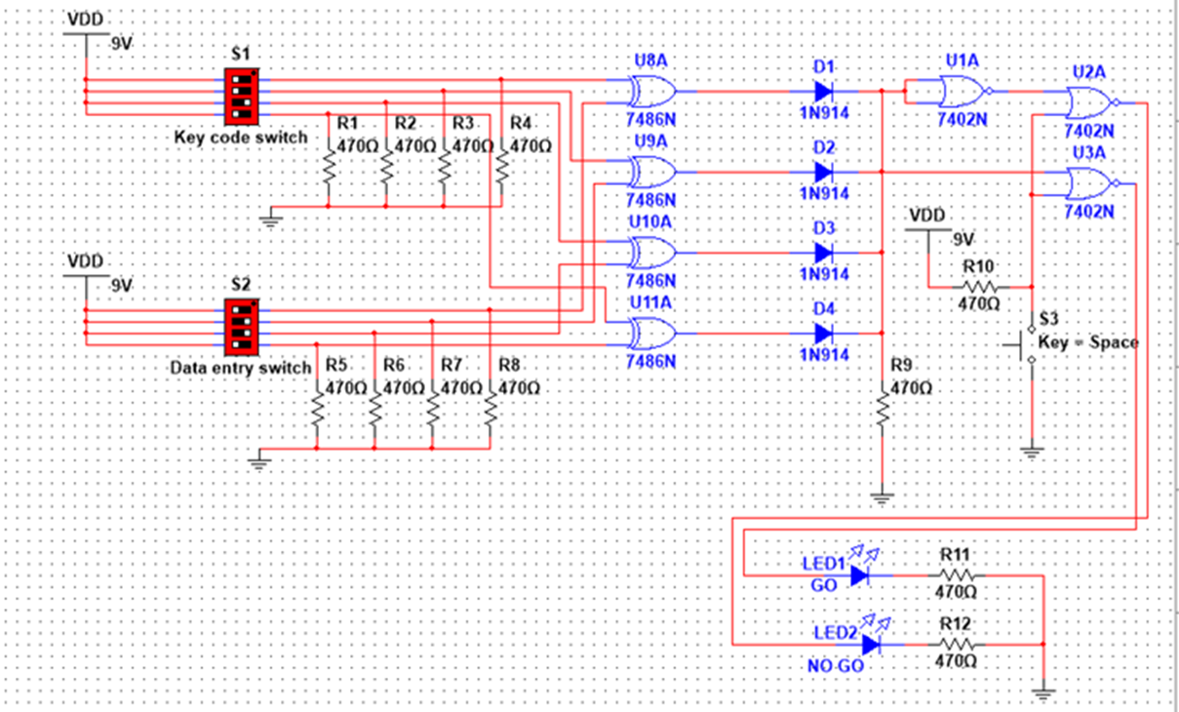
DESIGN
COMPONENTS
IC
Diodes and switches
Resistors
Miscellaneous
THEORY OF OPERATION
EXPECTED OUTPUT

Slide 4
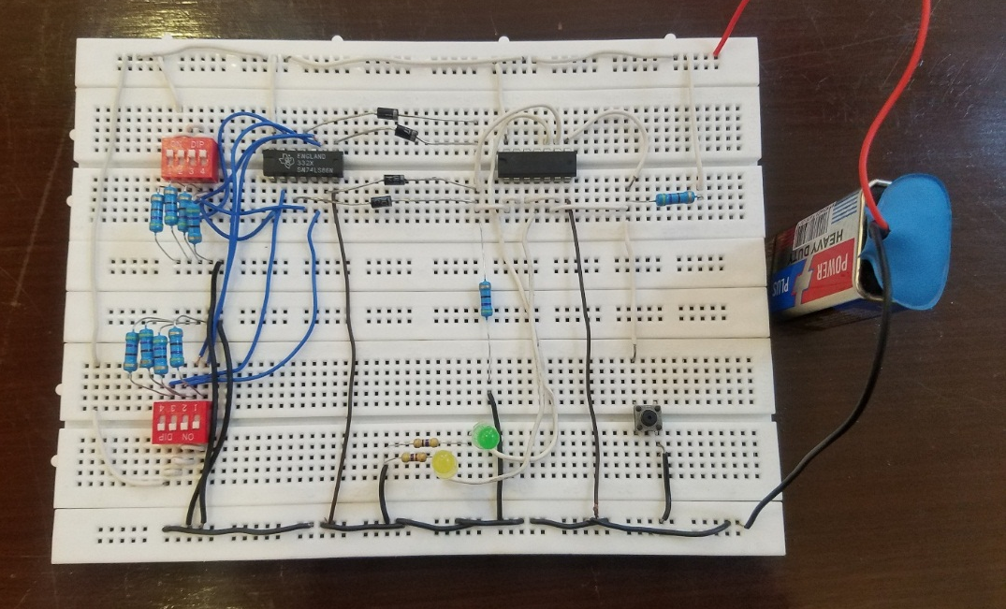
IMPLEMENTATION
Circuit on Bread board
Dip Switches
XOR Gate Function
NOR Gate Function
Diodes as OR Gate

Slide 5





TESTING
This is the result that we get after testing

Slide 6
CONCLUSION
The IC’s were tested and results found were exactly similar to the required results. It was concluded that we have learnt the following things:
• To patch the circuit containing different logic gates.
• Using XOR gates as bit comparators.
• How to build simple gate functions with diodes .
• Using NOR gates as controlled inverters.

Slide 7
THANKS
ANY QUESTIONS?

